Slide 1
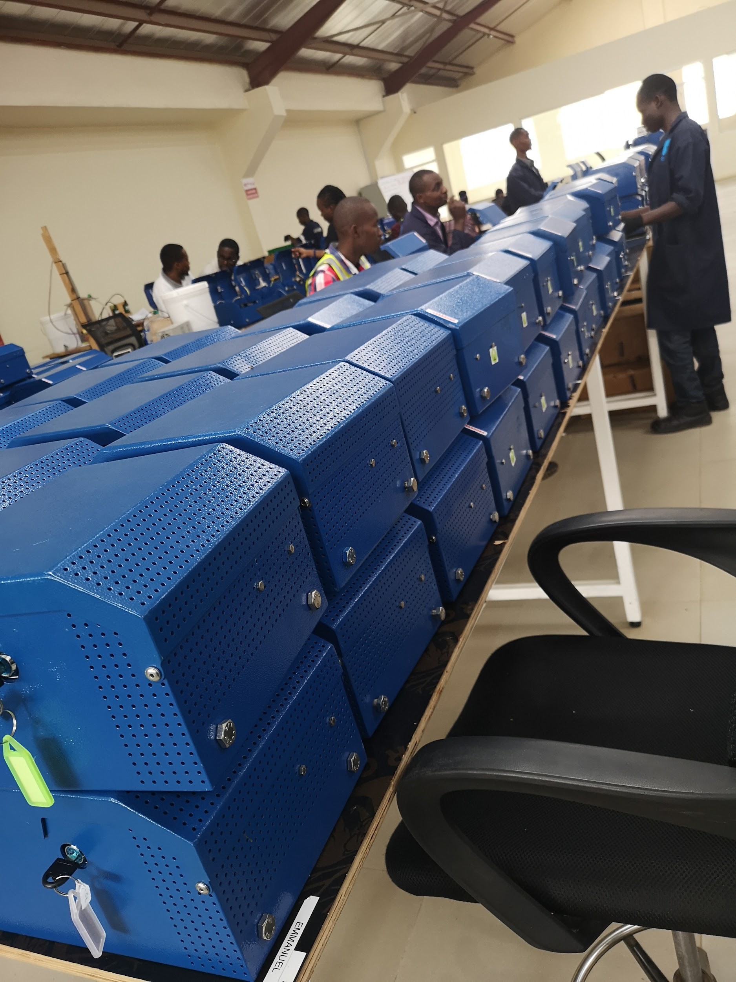
REFILL BOX
Incoming & Functionality QC Report

Slide 2
QC Passed Refill Box
Summary:
Visual checklist QC Passed upto date 157 RF Box.
Functionality QC passed upto date is 157RF Box refer to functionality report by end of day to know exact passed
Refill box QC Failed during functionality process - 0
Actual functionality QC output per person per day 60 RF Box.
Actual Checklist QC output per person per day 30
Refill box QC Failed during incoming QC process - 52
Initial refill box were 44 which came in earlier

Slide 3
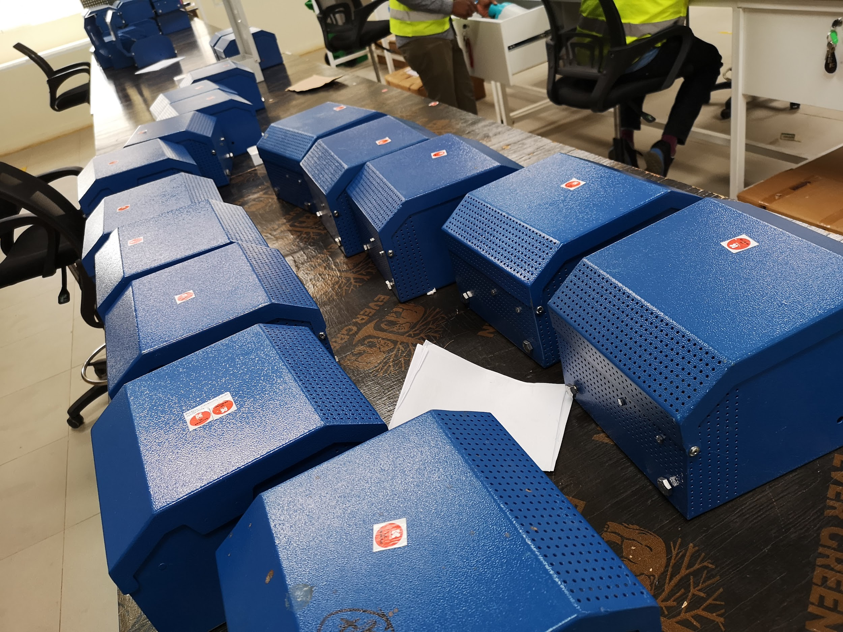
QC Failed Refill Box
Summary
Total Incoming QC Failed refill box upto date are 52 Refill Box
Most of the Failed Refill box come without fastener.

Slide 4
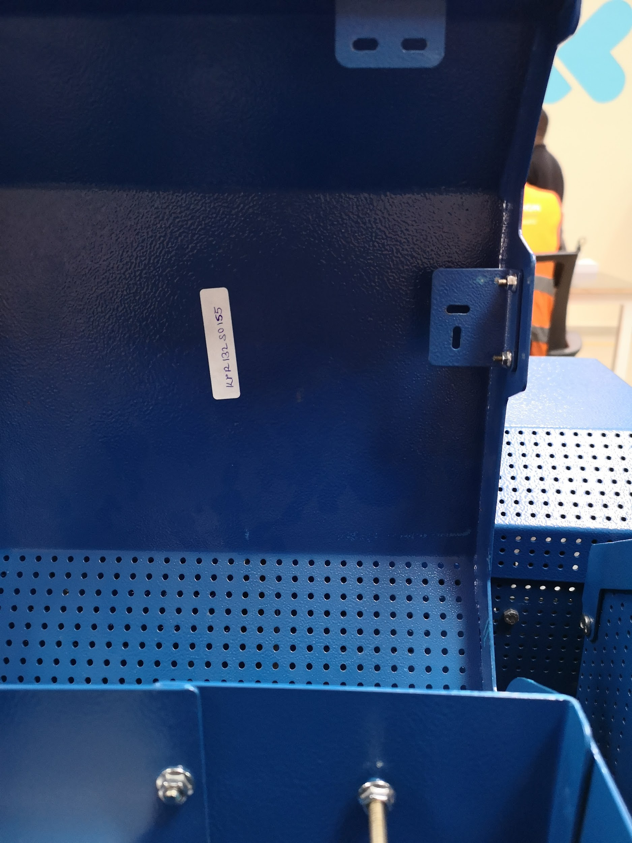
Fastener
No Fastener
No fastener for the Reed switch and door latch brackets
M3 X 10 Hex Bolt
M3 Flange Nut
Need to source more refill box fasteners

Slide 5
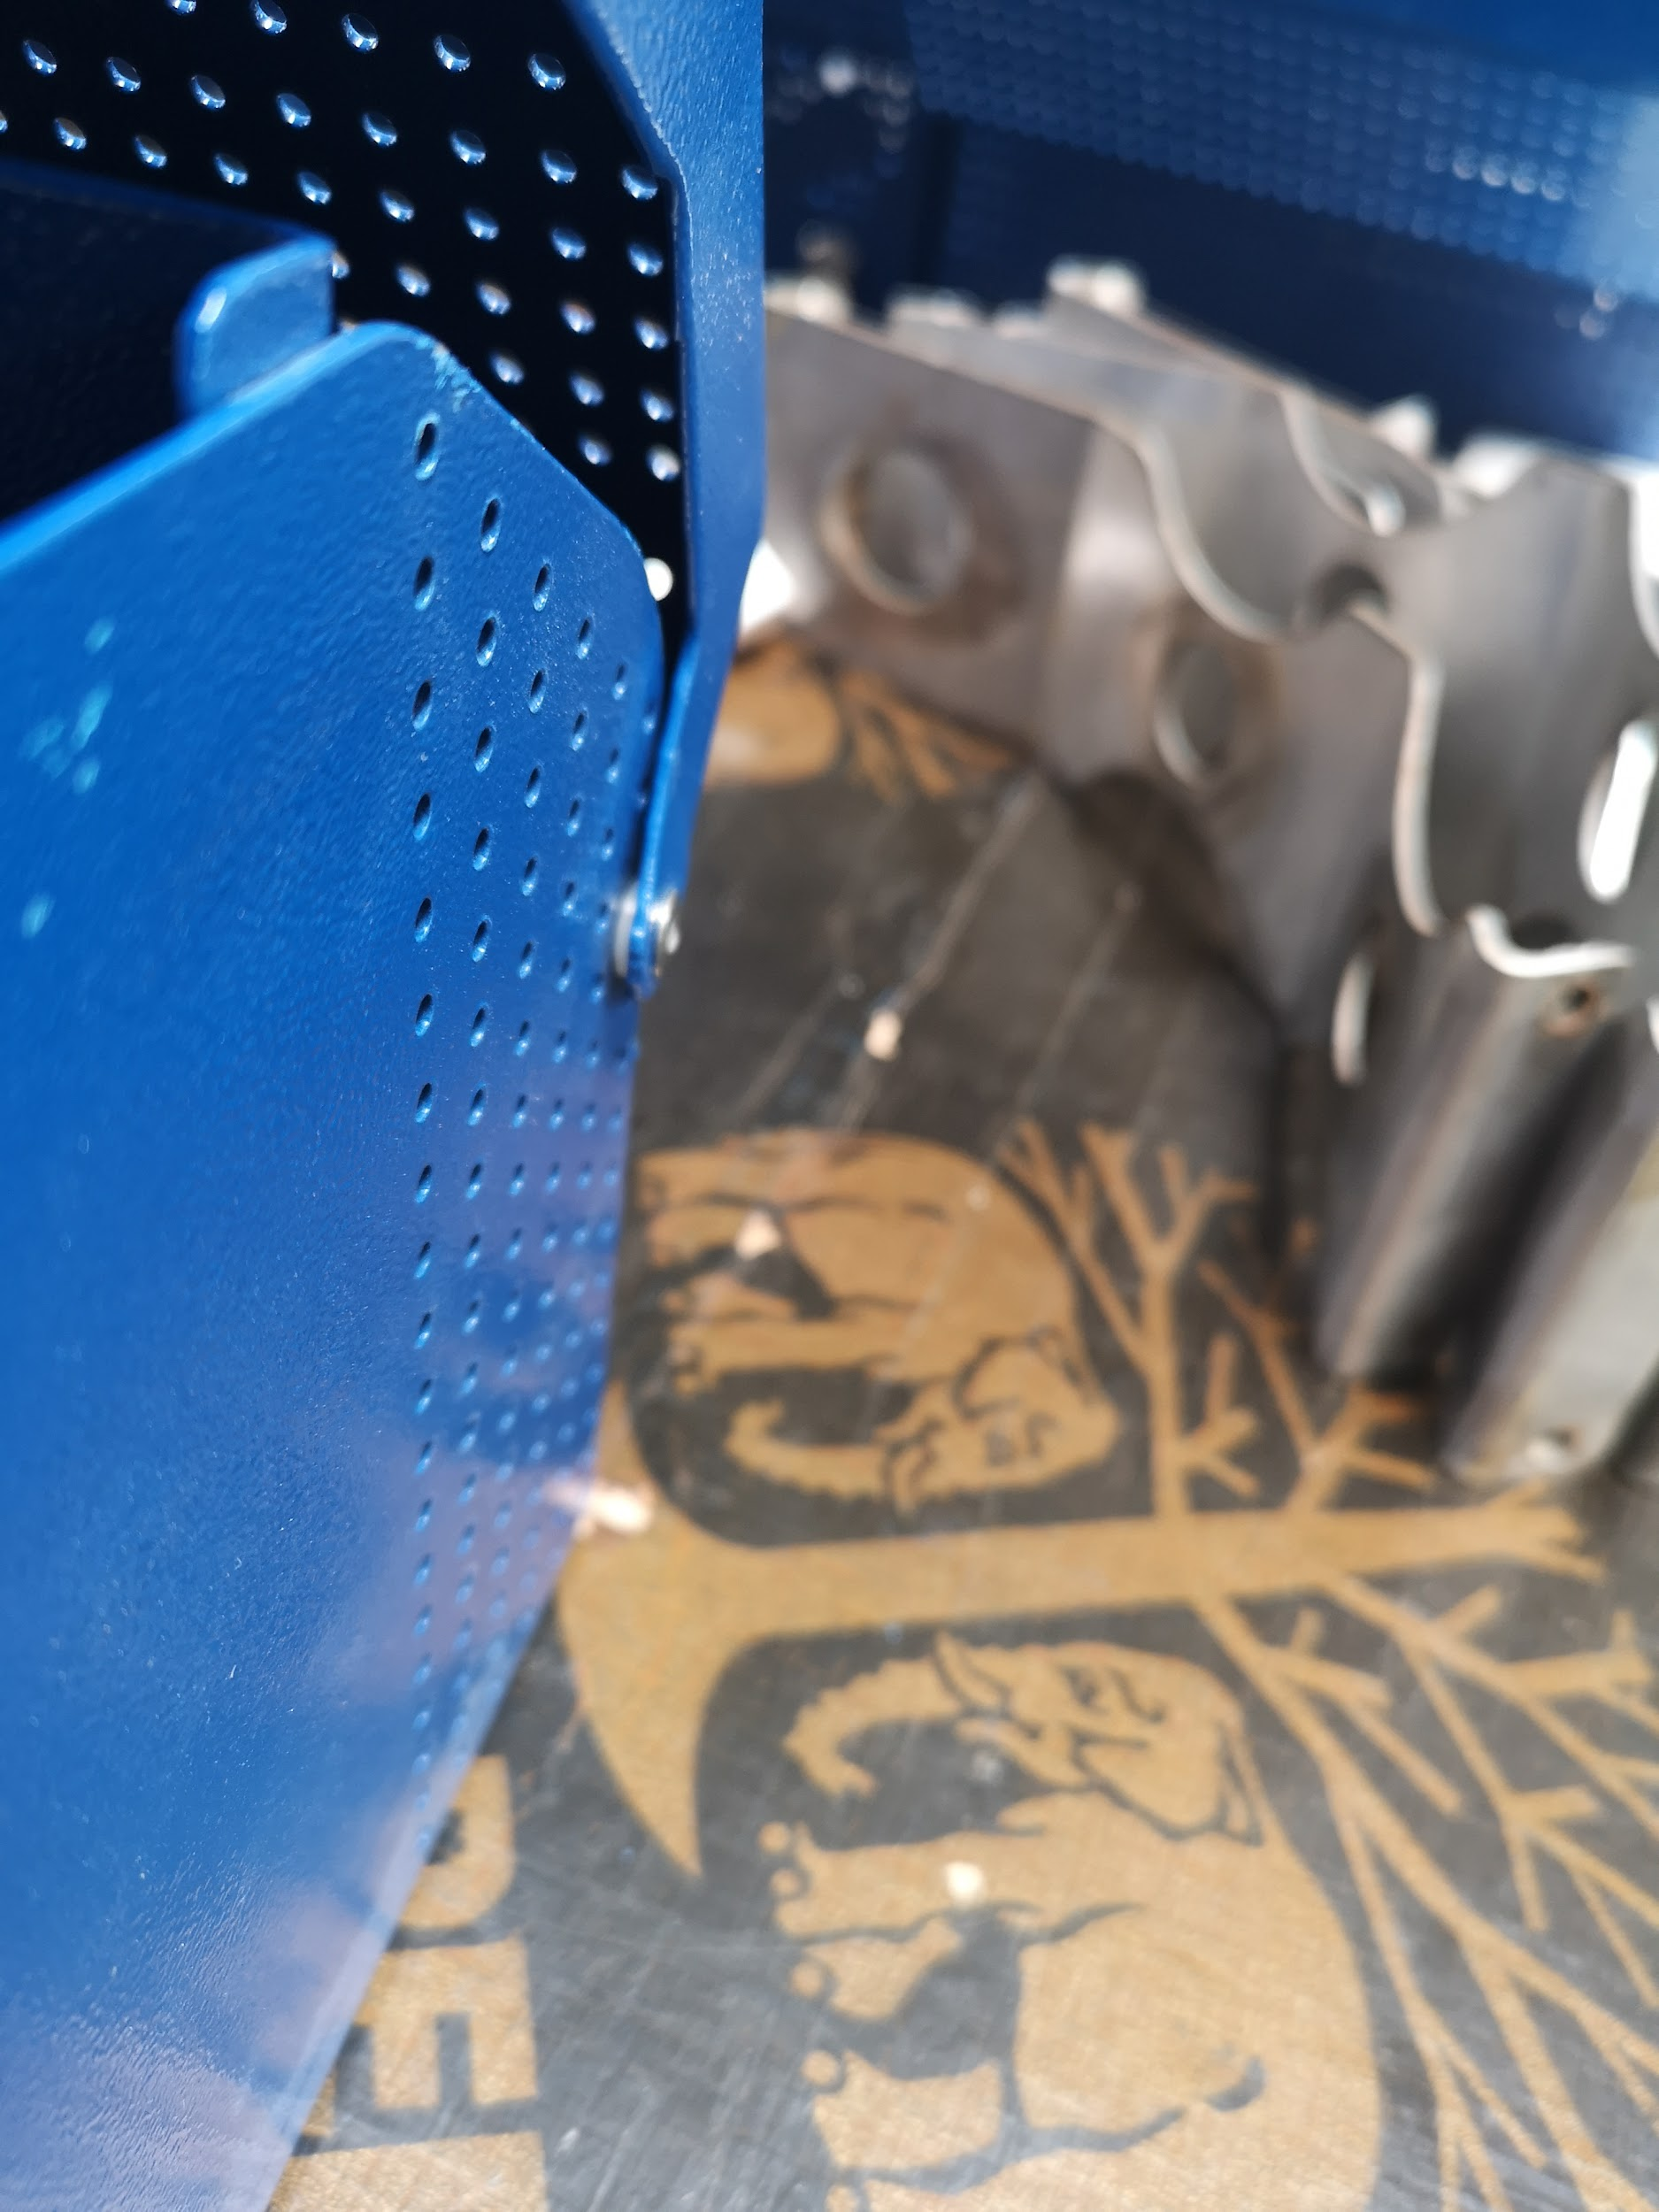
Refill Box With Washer at the door
With Washer

Slide 6
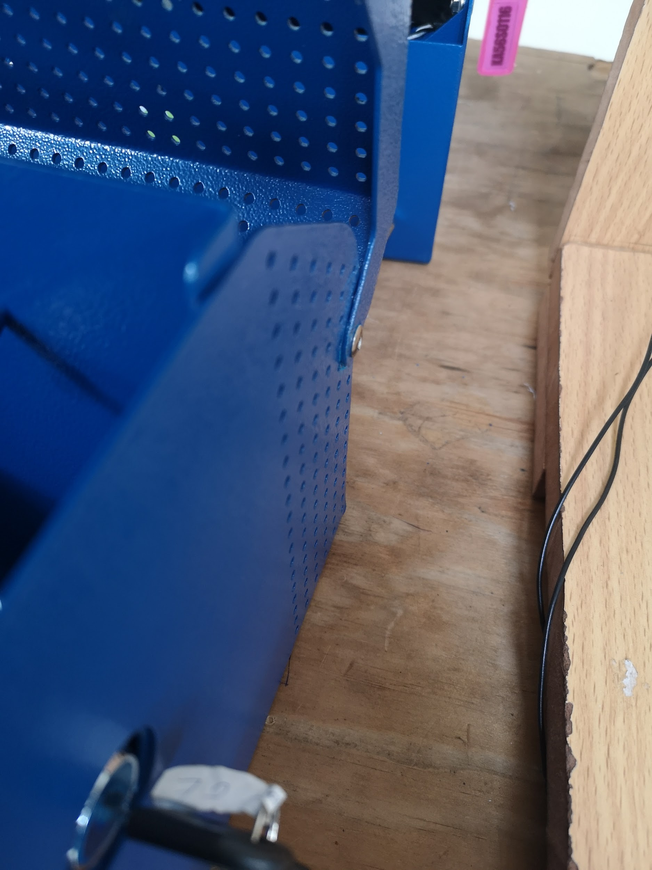
Without Washer

Slide 7
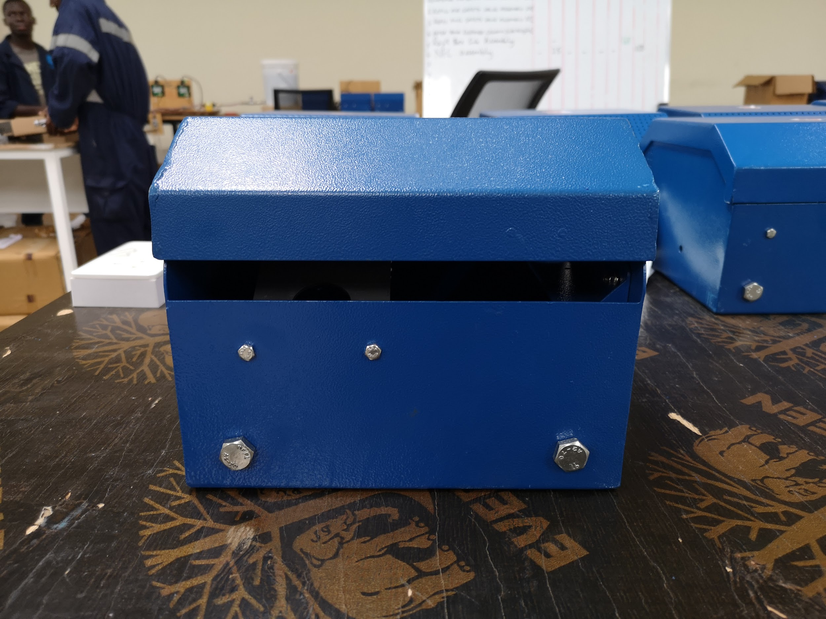
Gap when fully closed
More than 12 refill box have Space between door and body when fully closed
Suspected error during bending- Root cause to be investigated
GAP

Slide 8
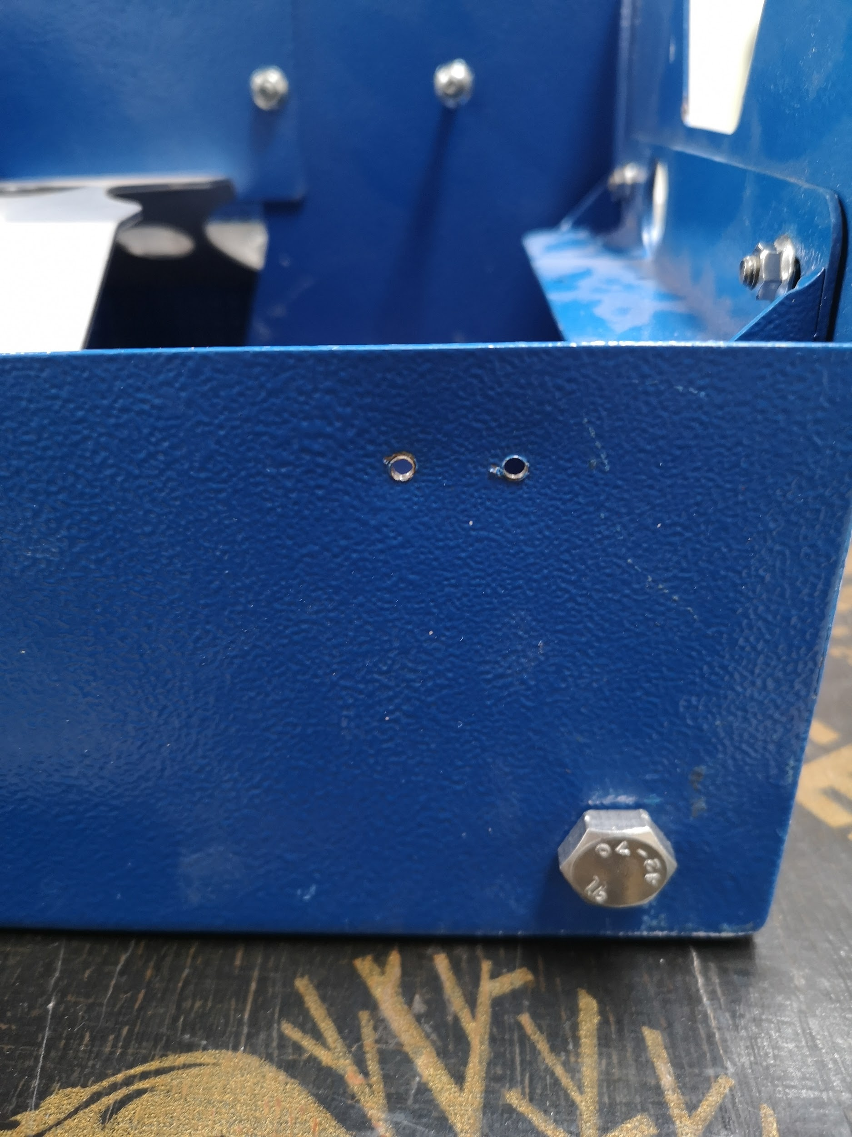
Short/Loose Studs
No studs to hold Body reed switch for 2 refill box
Studs coated with the paints- very hard to screw the nut.
No Studs

Slide 9
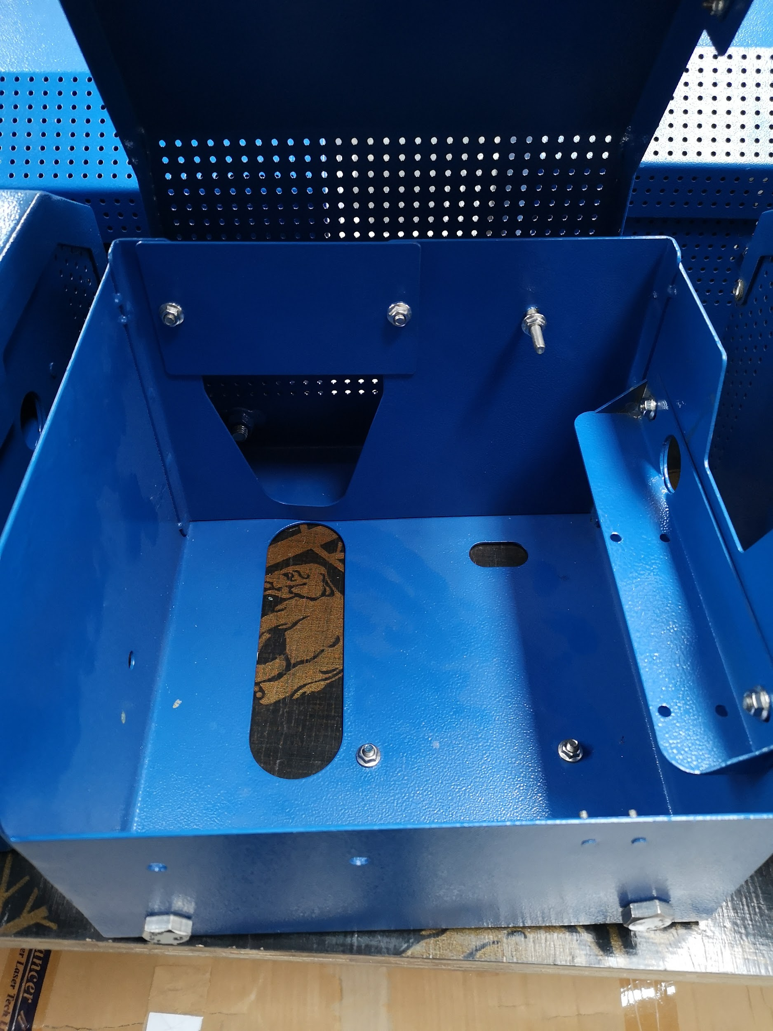
Parts Missing
No coupling holder on 1 refill box

Slide 10
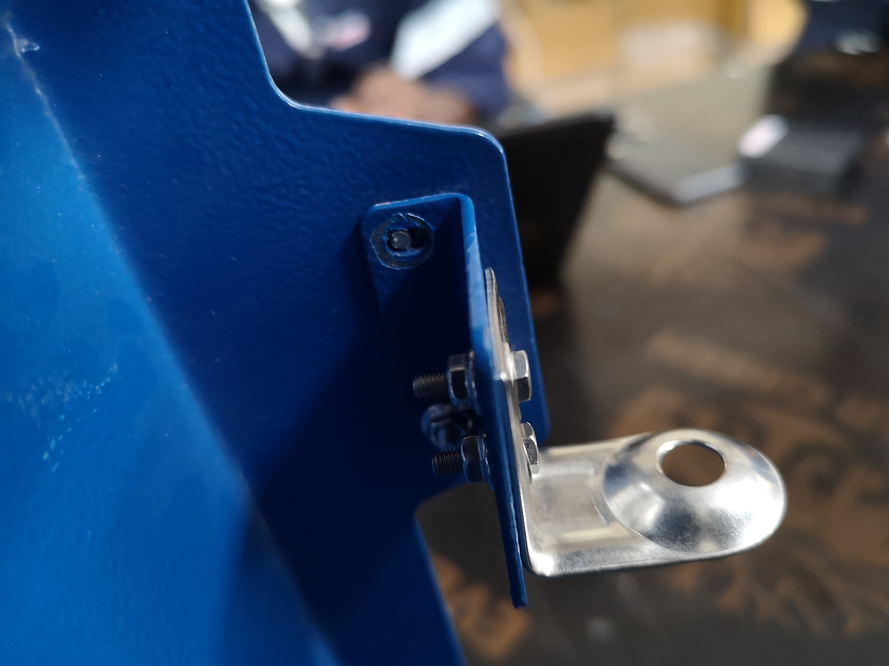
Short/Broken Studs
2 Refill box have broken studs
1 Refill box had short grounding studs
Short Stud

Slide 11
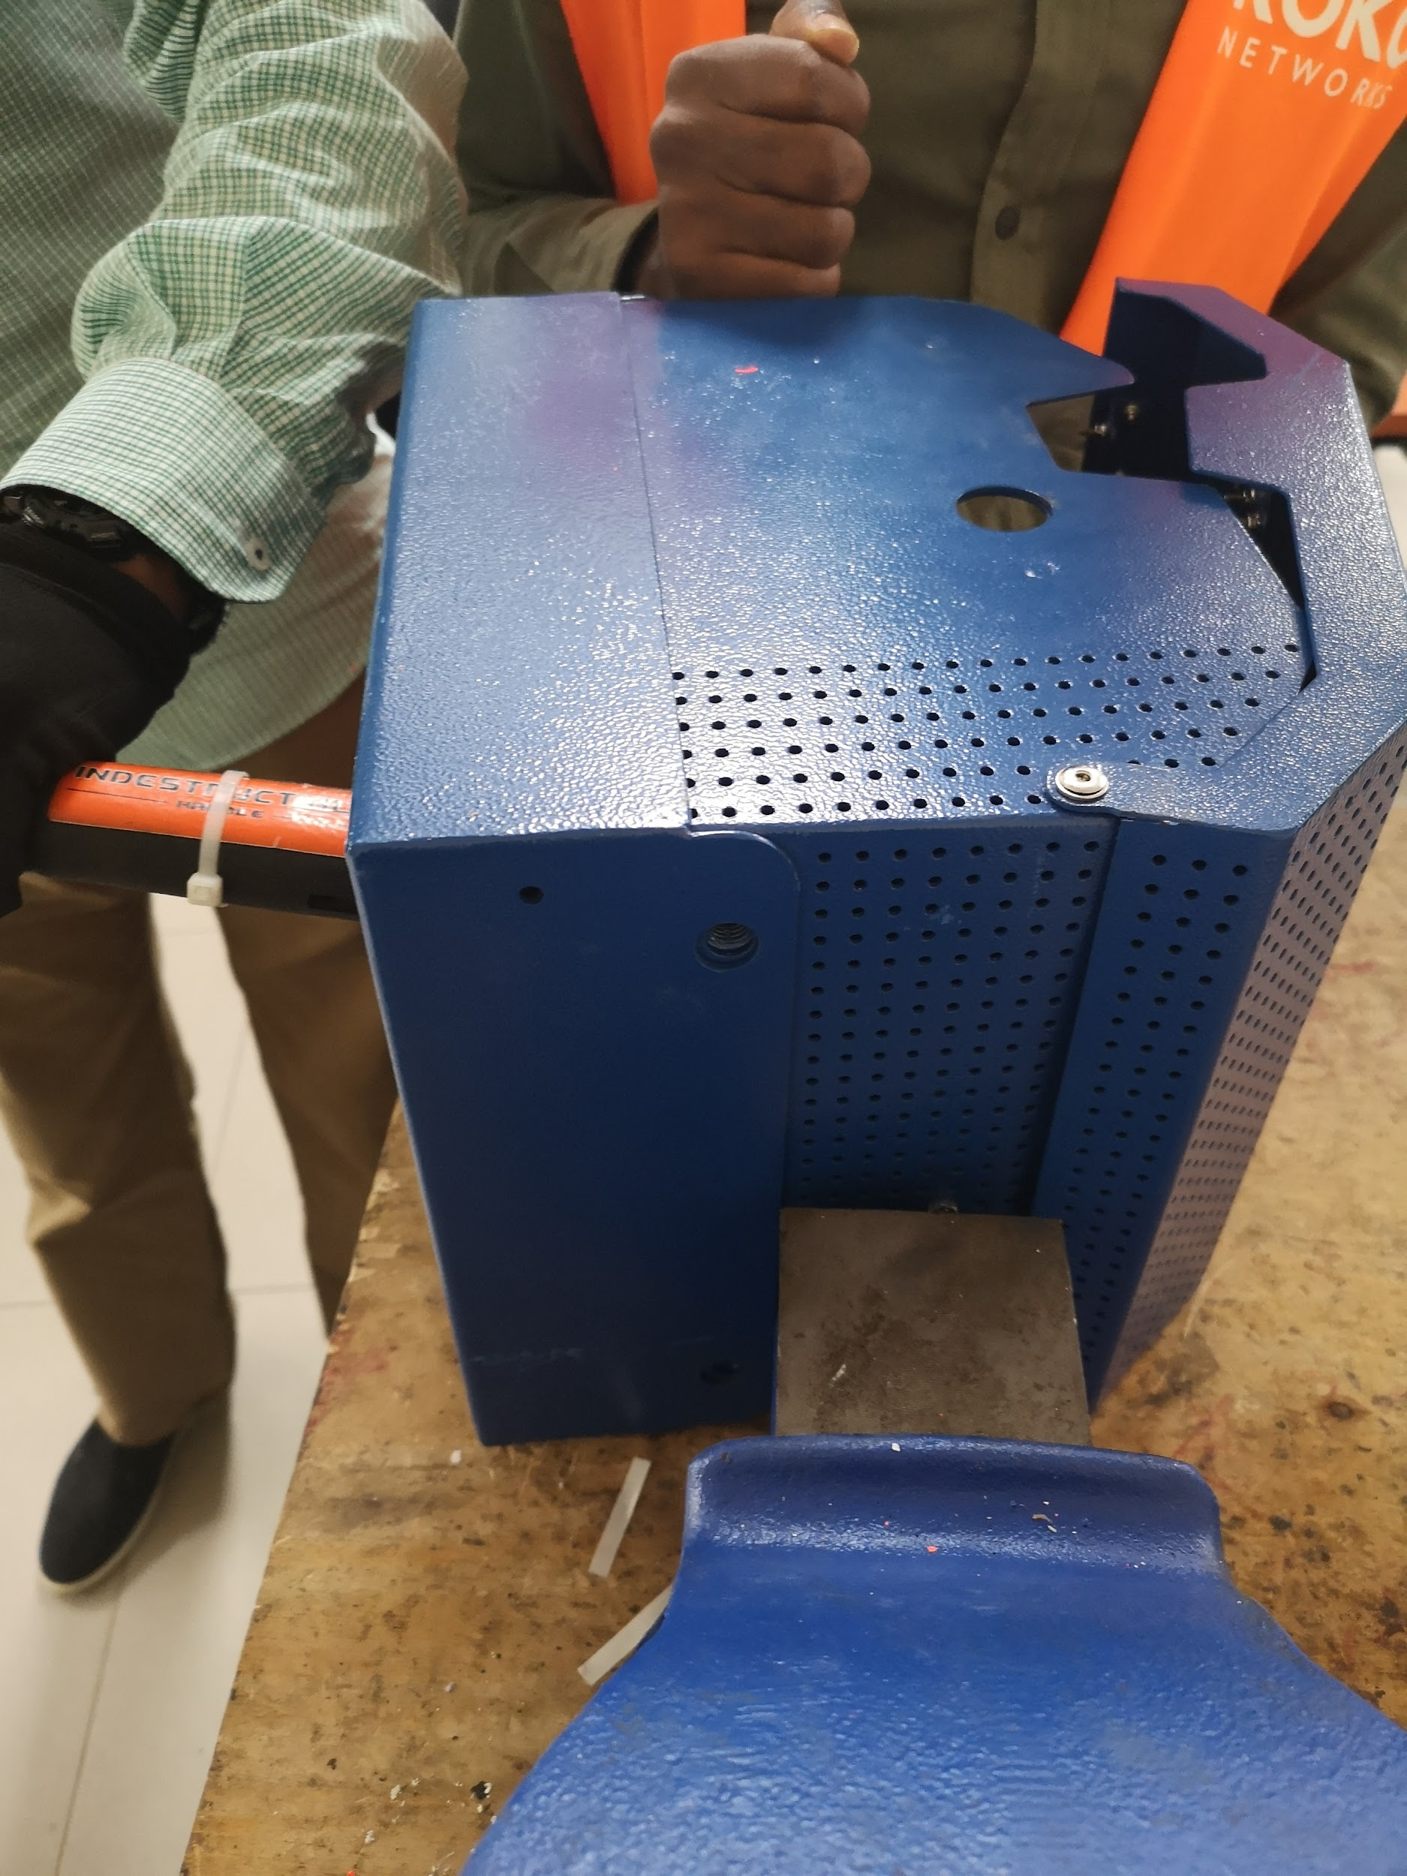
Dent, Scratches and refill Bracket
12 Refill box was stuck on refill bracket
Dents and scratches were observed on 12 refill box
Refill Box Bracket
Refill Box

Slide 12
Overall QC Summary
Below is the Refill box QC Functionality QC
Refill Box Functionality QC Report
52/210 Refill Box Failed during Incoming good QC.
Most Incoming Refill Box Failed because they had no fastener.
Most of the refill box door and body could not flash when closed.
Refill box fastener should be sourced as Guided on this sheet
Initial refill box were 44 which came in earlier in Dec
Manufacturer/Fabricator
Fabricator should Improve on bending and cutting errors
Should Improve on painting- Studs should be covered before commencing painting
Should reduce/eliminate dents and scratch
Should include allowance between Refill box body and refill box bracket ( for easier removal of refill bracket)

